Slide 1
Bank Loan CaseStudy
This case study gives me an idea of applying EDA in a real business scenario. In this case study, apart from applying the techniques that I have learnt in the EDA module, I’m also able to develop a basic understanding of risk analytics in banking and financial services and understand how data is used to minimize the risk of losing money while lending to customers.
My Approach:
There is enormous dataset I haven’t work before on such big and massive datasets. So before starting analysis I sort the data as per my understanding and requirements, I drop few columns which are useless in my analysis and identify missing values by doing cleaning of datasets. The reason behind removing the columns and removing duplicates is just to make my dataset more clean and easy to access as these dataset are enormous.
I use countblank function to identify the missing value and apply iferror function to normalize the dataset.
Tools Used: Microsoft excel 2021 and Tableau Public.

Slide 2
Using Current Application Dataset First.
Following the data cleaning procedure, I split the columns into two categories of variables:
Categorical Variables
Numerical Variables
Q:- Identify the Outliers: The outliers can be identified on numerical column, So I try correlation between my selected variables. In excel I find out my Upper limit and Lower Limit to by using first quartile and third quartile function along with inter quartile range.
I used box plot in tableau public to visualize the outliers with reference the category ‘Target’ Vs Amount Credit, Amount Income, Amount Annuity.
In the next slide you can easily identify the outliers as per my plotted observation.

Slide 3
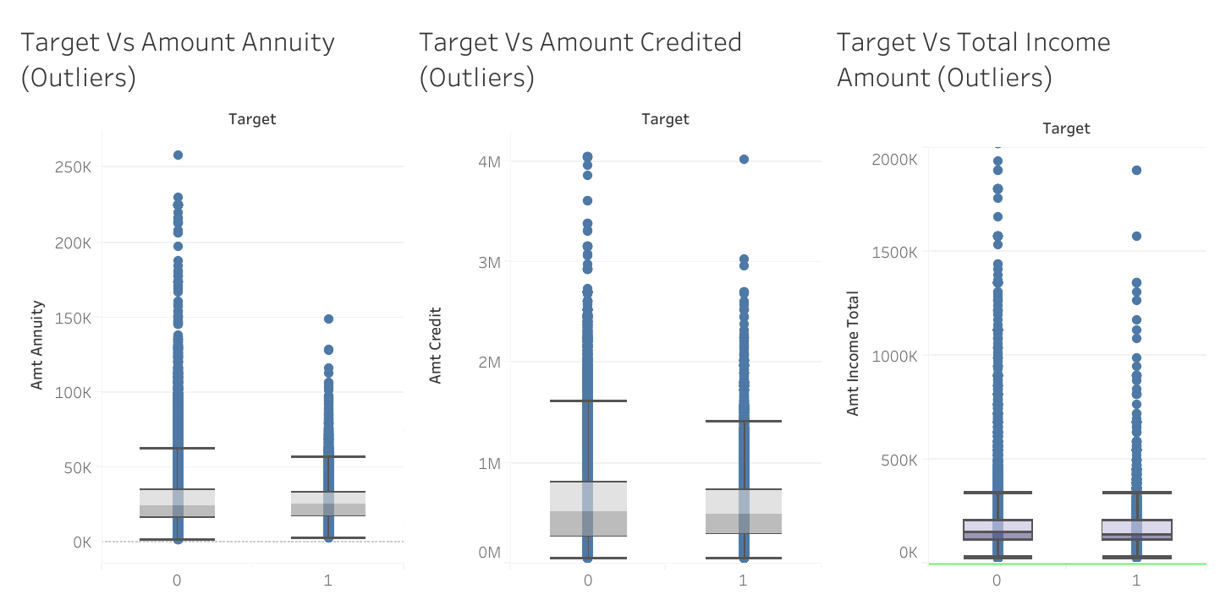

Slide 4
Q:- Data Imbalance: When data is distributed in unequal manner then data imbalance happened. To figure out the data imbalance I used pivot table and tableau public to analyze the report and plot the data imbalance. In my first chart of Age Groupwise Imbalance I opt for pivot table and convert the birth days column into years using datediff function, then group the age into groups of 10 years each and count the client id to plot the data.

Slide 5
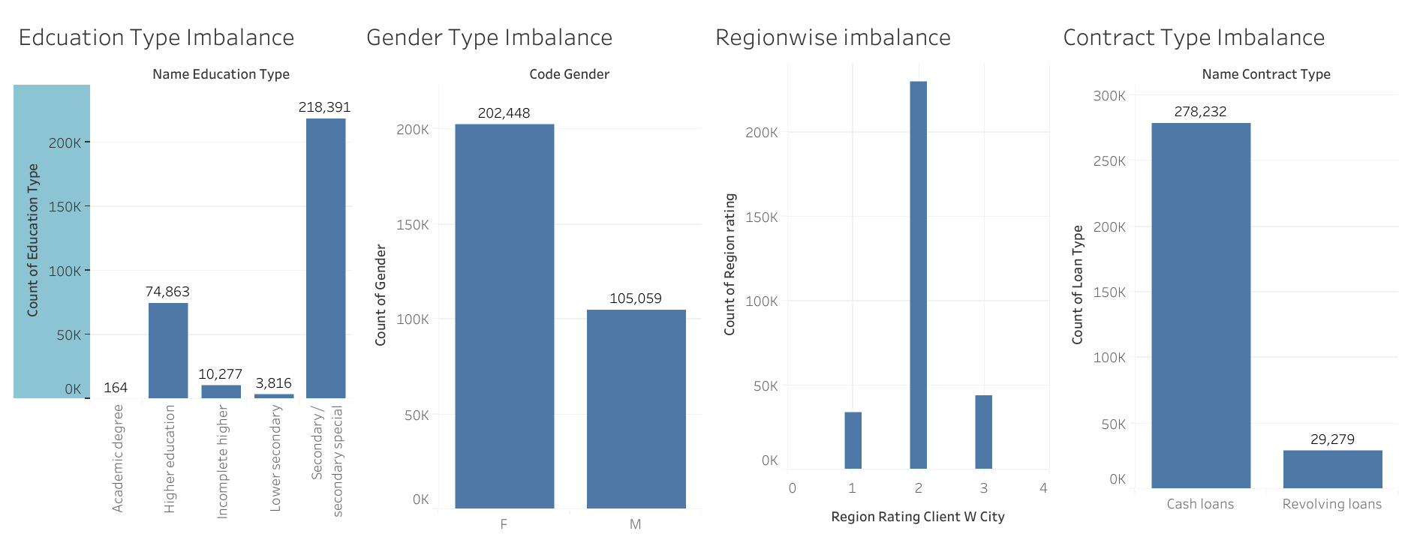

Slide 6
Q:Bivariate Analysis: We establish cause and effect relationship between variables, it is slightly more analytical than univariate analysis because it not only restricted to description. For this dataset I'm trying to create relationship with two variables independently with target column. Customer who live in low- rating areas will have higher defaults, low income earning clients will have high chance of default, females are less probability to make defaults than males, clients with less educational qualification are most likely to pay installments of loan.

Slide 7
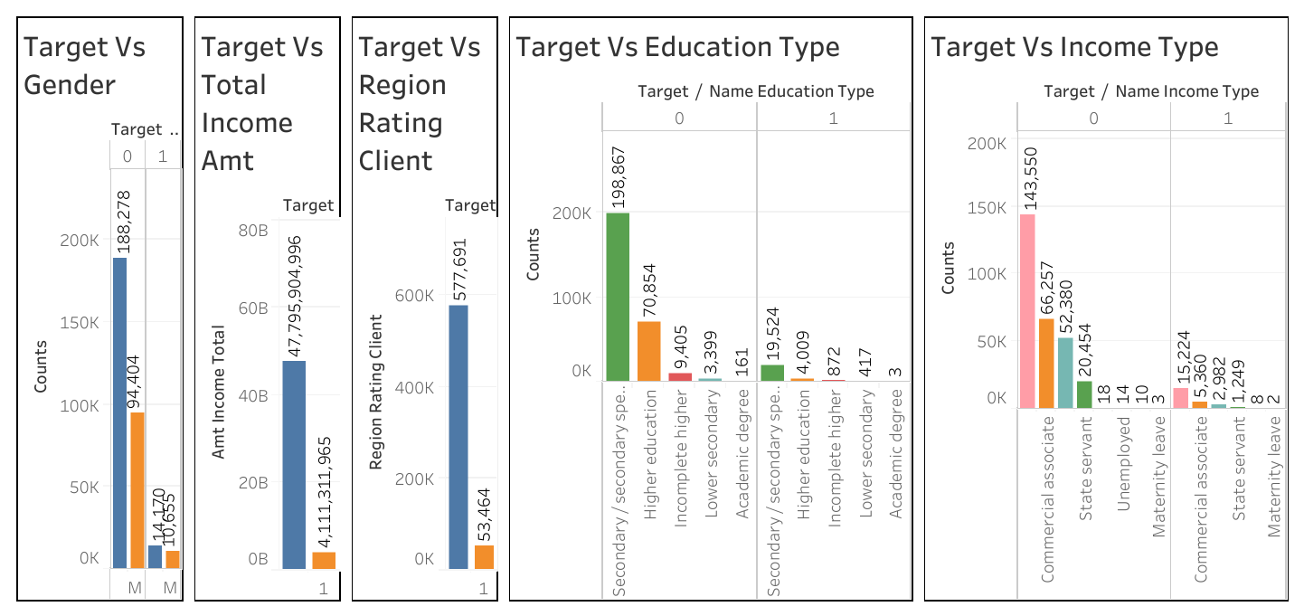
Bivariate Analysis

Slide 8
Q:Univariate Analysis: There is only one variable and this analysis does not deal with cause or effect relationship we can establish relation because there is only single variable involved. We simple describe the data and find out pattern that followed in that data. Clients with higher income are less interest to apply for loan. The Credit amount of loan is deliberately are in the range of 45000 to 1045000 ( Using min and mx function in excel). The major applicants for loan are those whose age is between 35 to 50 years old. Those who are earning less are seeking more for loans. Those people who are married and have their own home are more intended to take loans again. Please refer the dashboard for more understanding how the data represent the univariate among chosen variables.

Slide 11
Q:Top Ten Correlation (Using Correlation matrix)
Red color define: -1 correlation coefficient
White Color Define: 0 correlation Coefficient
Blue color Define: 1 correlation coefficient
 | DAYS_REGISTRATION | CNT_CHILDREN | AMT_INCOME_TOTAL | AMT_CREDIT | AMT_ANNUITY | AMT_GOODS_PRICE | DAYS_BIRTH | DAYS_EMPLOYED | REGION_RATING_CLIENT | CNT_FAM_MEMBERS
DAYS_REGISTRATION | 1
CNT_CHILDREN | 0.183395284 | 1
AMT_INCOME_TOTAL | 0.02780542 | 0.012882077 | 1
AMT_CREDIT | 0.009621326 | 0.002145443 | 0.156870272 | 1
AMT_ANNUITY | 0.038514246 | 0.021373778 | 0.191657428 | 0.770138003 | 1
AMT_GOODS_PRICE | 0.011564978 | -0.001827168 | 0.159610064 | 0.986968305 | 0.775109273 | 1
DAYS_BIRTH | -0.331912082 | -0.330937668 | -0.027260873 | 0.055435947 | -0.00944547 | 0.053442309 | 1
DAYS_EMPLOYED | -0.214573002 | -0.241582844 | -0.063835353 | -0.064318887 | -0.102851483 | -0.062264996 | 0.623940917 | 1
REGION_RATING_CLIENT | 0.080210445 | 0.025422947 | -0.085465189 | -0.101776386 | -0.128524581 | -0.103786297 | -0.00936065 | 0.033045946 | 1
CNT_FAM_MEMBERS | 0.173416271 | 0.87916064 | 0.016341589 | 0.063159813 | 0.075539282 | 0.061185443 | -0.27889359 | -0.234364722 | 0.029687904 | 1

Slide 12
Using Previous Application Dataset. Following the data cleaning procedure, I split the columns into two categories of variables: Categorical Variables Numerical Variables Q:- Identify the Outliers: The outliers can be identified on numerical column, So I try correlation between my selected variables. In excel I find out my Upper limit and Lower Limit to by using first quartile and third quartile function along with inter quartile range. I used box plot in tableau public to visualize the outliers for given variables independently Amount Credit, Amount Annuity, Amount Application. In the next slide you can easily identify the outliers as per my plotted observation.

Slide 13
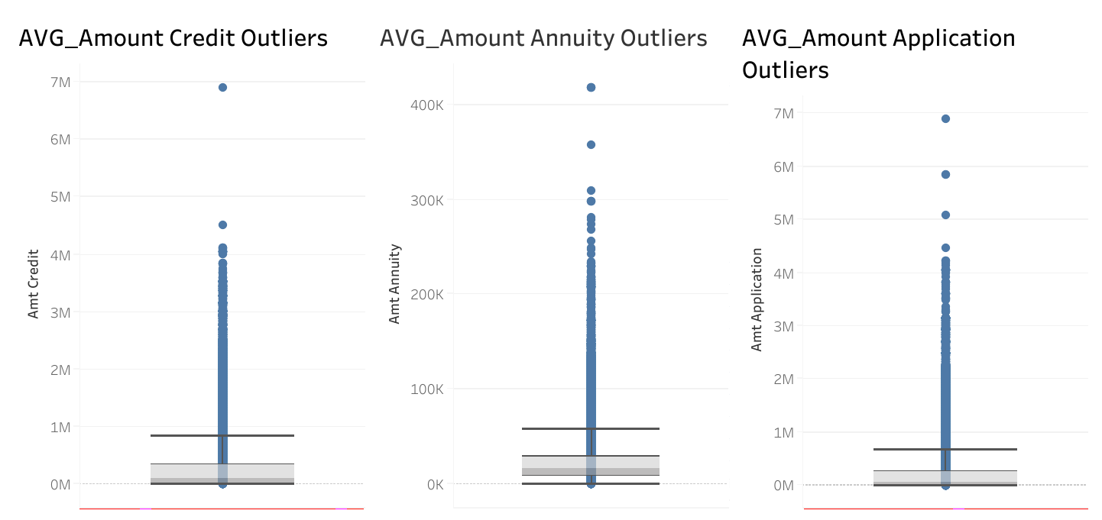
Outliers:

Slide 14
Q:- Data Imbalance: When data is distributed in unequal manner then data imbalance happened. To figure out the data imbalance I used pivot table only to analyze the report and plot the data imbalance. In My analysis I opt for 4 different variables where I found the loan is unevenly distributed, due to this uneven distribution of loan the chances of default or business loss would be more high in next time. Like people applied for small amount of loan is enormously small so here the bank will account small business only. When application is for small amount loan the bank sanction the same and at the end return would be small so big loss for bank. In seller place area bank sanction the loan amount more into negative area so very high risk of fraudulent activity is possible. Cash loan purpose is unidentified where application received more comparatively other purpose category, so big risk of default here. Pls refer the next slide for more understanding.

Slide 16
Q:Univariate Analysis: There is only one variable and this analysis does not deal with cause or effect relationship we can establish relation because there is only single variable involved. We simple describe the data and find out pattern that followed in that data. Clients have more often chosen cash and revolving loans and on the right hand the clients are repeaters who repeat to take the loans or they are Banks's repeated clients. Then in next analysis the major clients are individual who applied for loans and their decision time is less than 10 months and then followed consumer electronic goods clients. Please refer the dashboard for more understanding how the data represent the univariate among chosen variables.

Slide 18
Q:Bivariate Analysis: We establish cause and effect relationship between variables, it is slightly more analytical than univariate analysis because it not only restricted to description. For this dataset I'm trying to create relationship with two variables independently with target column. Clients who apply for higher amount loan like above 3 lacs amount are mostly cancelled and majority of clients whose loan got cancelled are from Credit and Cash Agencies. In Next, New clients are enjoyed because majority of them got approval for loan while at other hand majority of repeat client loan application got cancelled. While Undefined industry client (XNA) seeking loan for self use are mostly got cancelled. On other hand cash loan requirement application are almost equally approve and cancelled ( ratio are almost similar). Please refer next two slides for better understanding.

Slide 21
Q:Top Ten Correlation (Using Correlation matrix)
Red color define: -1 correlation coefficient
White Color Define: 0 correlation Coefficient
Blue color Define: 1 correlation coefficient
 | AMT_ANNUITY | AMT_APPLICATION | AMT_CREDIT | AMT_DOWN_PAYMENT | AMT_GOODS_PRICE | DAYS_DECISION | SELLERPLACE_AREA | DAYS_FIRST_DRAWING | DAYS_FIRST_DUE | DAYS_LAST_DUE_1ST_VERSION
AMT_ANNUITY | 1
AMT_APPLICATION | 0.792038802 | 1
AMT_CREDIT | 0.803238344 | 0.974983899 | 1
AMT_DOWN_PAYMENT | 0.312886894 | 0.615856036 | 0.423407134 | 1
AMT_GOODS_PRICE | 0.802510803 | 0.999853727 | 0.992298236 | 0.615856036 | 1
DAYS_DECISION | 0.209590782 | 0.033412823 | 0.009303947 | -0.012957825 | 0.229003047 | 1
SELLERPLACE_AREA | -0.073685136 | -0.023798278 | -0.029239812 | 0.036836373 | -0.066588865 | -0.107962582 | 1
DAYS_FIRST_DRAWING | 0.24888572 | 0.263420655 | 0.163163393 | 0.030162653 | 0.11851039 | 0.220972618 | -0.058571447 | 1
DAYS_FIRST_DUE | -0.191483209 | -0.174106563 | -0.130634291 | -0.010733409 | -0.145181538 | 0.128206632 | 0.102653152 | 0.085109504 | 1
DAYS_LAST_DUE_1ST_VERSION | -0.328115245 | -0.332422182 | -0.215627618 | -0.029616468 | -0.183858062 | -0.12150698 | 0.113830952 | -0.776060135 | 0.528736509 | 1

Slide 22
JOINING: I tried to Join these two given datasets to find out my last analysis to get the relationship who applied loan previously and currently also. I prefer Tableau Public to join these two dataset and get relation as per my observation. I found that those client who applied previously and got their loan sanctioned previously have also get approval currently and have no defaulters yet this time. Maximum number of loan sanctioned to “credit and cash agencies” this time as like previously. Please refer the next slide for detail understanding.

Slide 23
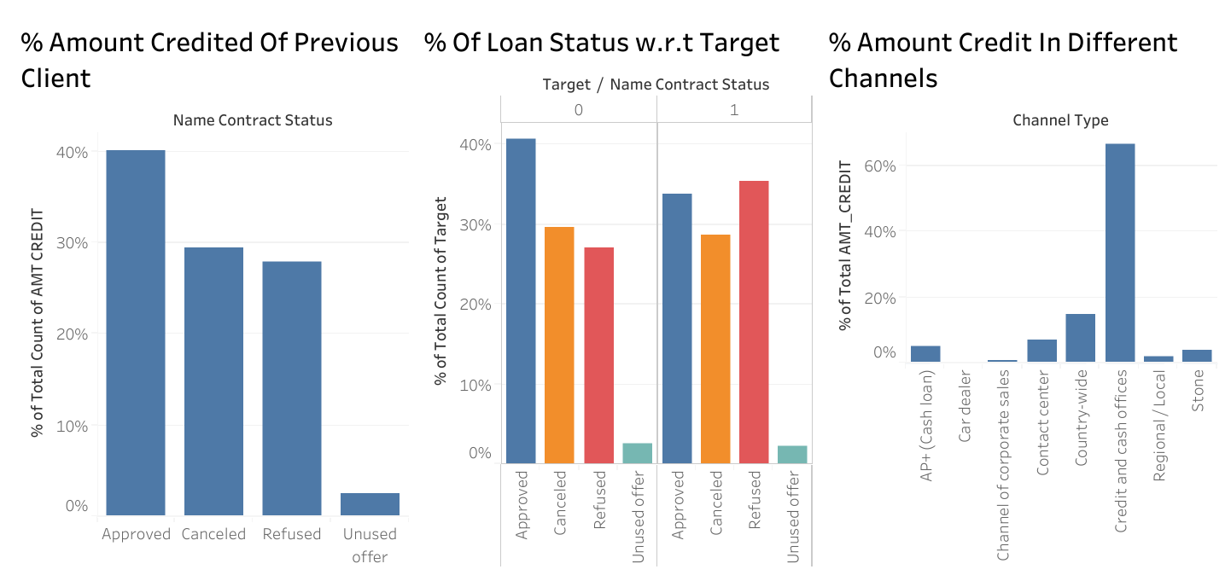

Slide 24
The End, Thank You.

